Slide 1
A Study of Sales Impact Factors in Sweden, Finland and Spain 10th of February at 15.00
Trelitha R. Bryant
VP, Field Testing & Research
Behavioral Sciences Research Press Inc.
November 2024
Notes:
Welcome
When not talking mute please

Slide 2
AN OPPORTUNITY TO GROWTH

Slide 3
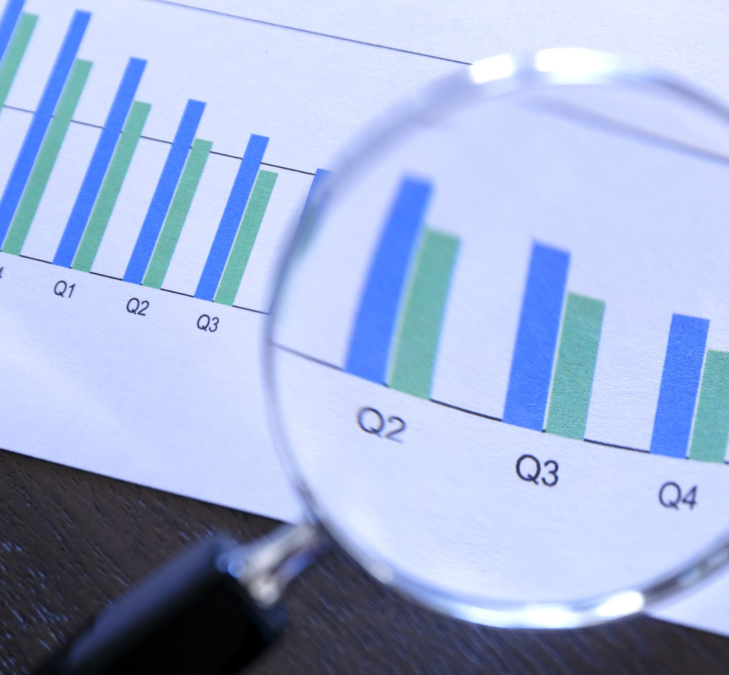
The different research areas covered
1. Pre- and Post COVID Research
2. Normative Profile Analyses
3. Gender Comparison Research
4. Research on Motivation and Goal Level

Slide 4
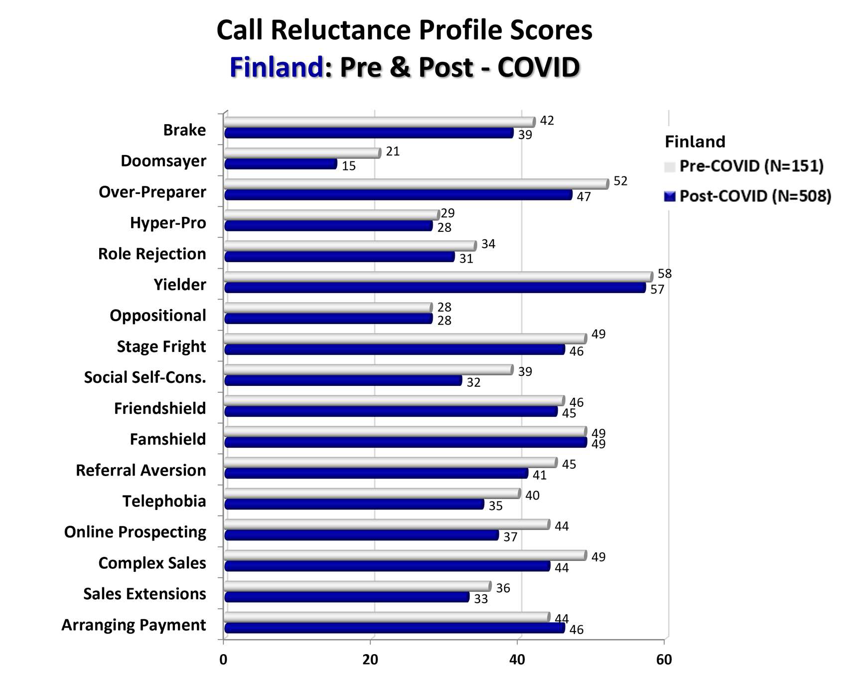
Scores Pre & Post Covid
Notes:
After covid it was a slightly increase in SCR in Sweden and in Finland the opposite
Interesting online discomfort actually went lower with 5 point. After Covid we are more comfortable using online media

Slide 5
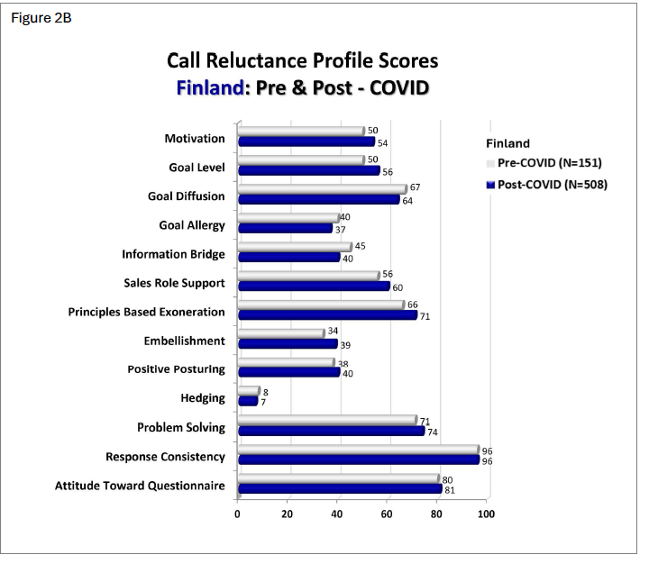
Scores Pre & Post Covid

Slide 6
SCR by Country
Notes:
Slightly lower SCR for Sweden with some exceptions
Hyper Pro
Role Rejection
Telephobia
Sweden are 4 points higher than Finland and Spain on these three

Slide 7
Most prevalent form of SCR by country
Notes:
Yeilder the most common means lack of assertiveness is common.

Slide 8
Impostor scores by country
Notes:
In Finland highest on Oppositional of the three countries also a very strong connection to Principle Based Exoneration

Slide 9
Notes:
No big differences between gender also a little bit unsecure due to low numbers

Slide 10
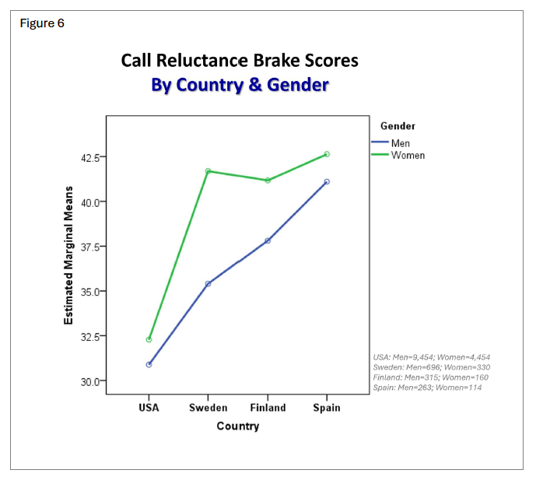
SCR Brake score by country
Notes:
There seems to be a slight difference in Sweden between men and women and still not so much we can draw conclusion on individual level.

Slide 11
Impostor Scores by country

Slide 12
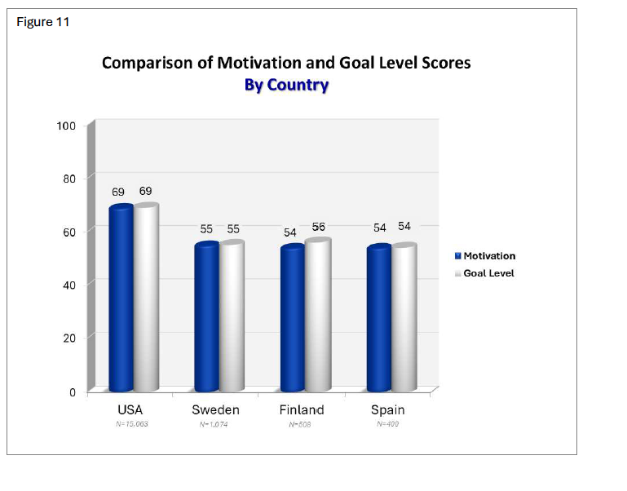
Motivation & Goal level by country
Notes:
The difference can be seeked by the compensationsystem wher US salespeople get more commission on crating new business/new clents

Slide 13
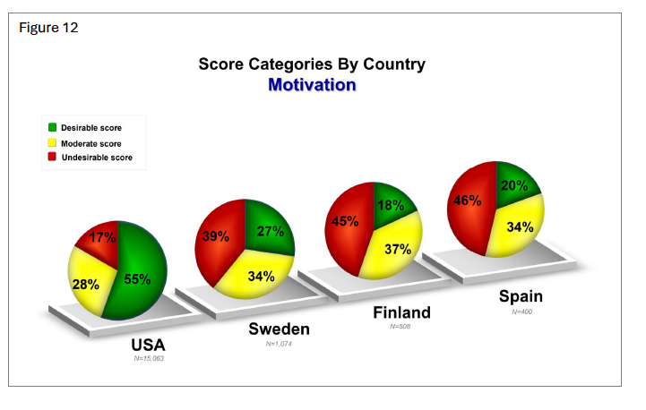
Motivation by country

Slide 14
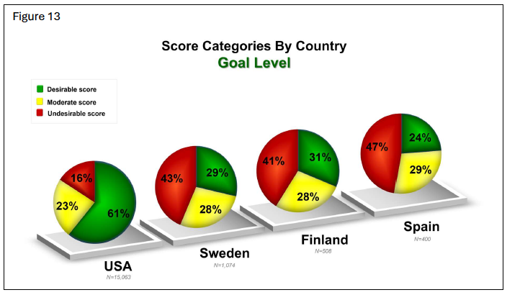
Goal Level by Country
Notes:
People that desire a higher income or are comfortable selling have a higher Motivation and Goal level stands out in Sweden where the effect size of this difference is the highest.

Slide 15
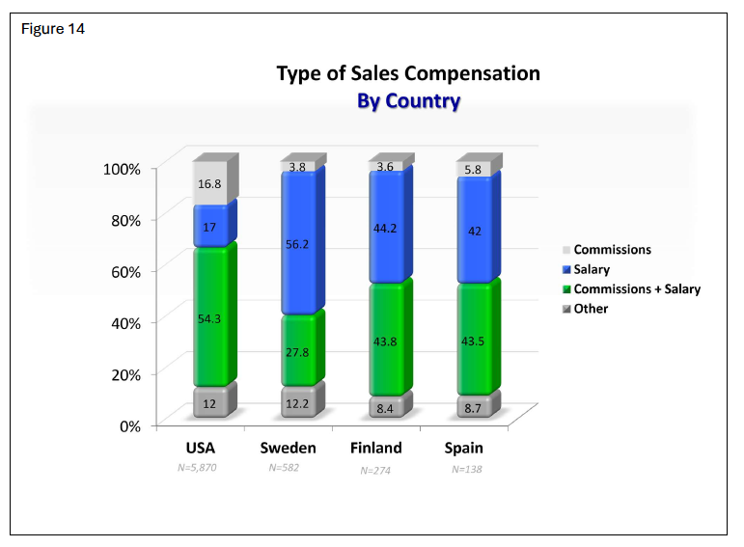
Type of Sales Compensation

Slide 16
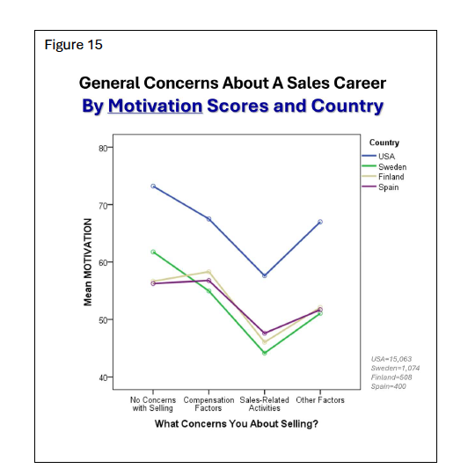
Concerns about a Sales Career
Notes:
If NO Concerns with selling - Higher Motivation
If NO Concernas about Selling Higher Goal Level
Interesting is that USA are so much higher than us in Europe

Slide 17
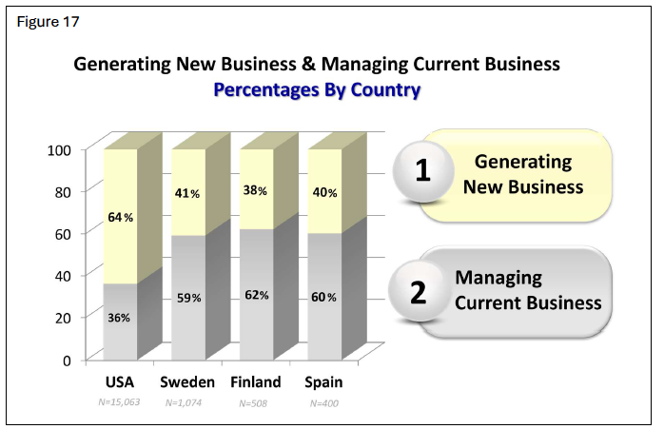
Generating New Business Versus managing current business
Notes:
What they are more competent doing
In USA more salespeople are focused on generating new business

Slide 18
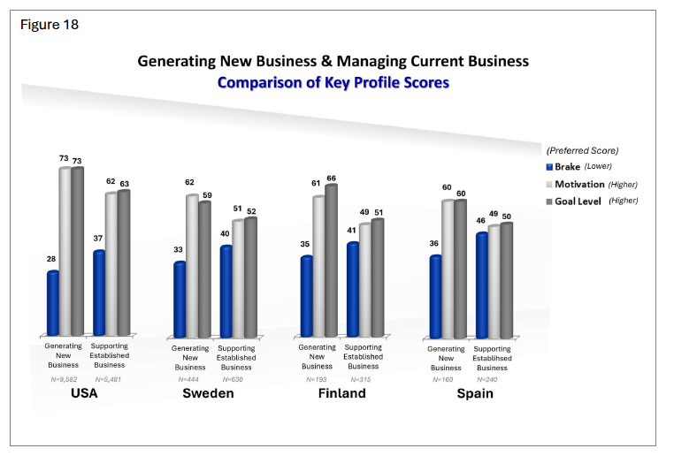
Differences in brake score if generating or supporting business
Notes:
Salespeople generating new business have lower brake and higher Motivation and Goal Level than salespeople with a focus supporting established Business.
Old thinking about Hunters and Gathers that is behind it ?????????? The way you think alters what you do and what you do alters what you feel. Please read SCR and Hunters&Gathers in the accreditation login

Slide 19
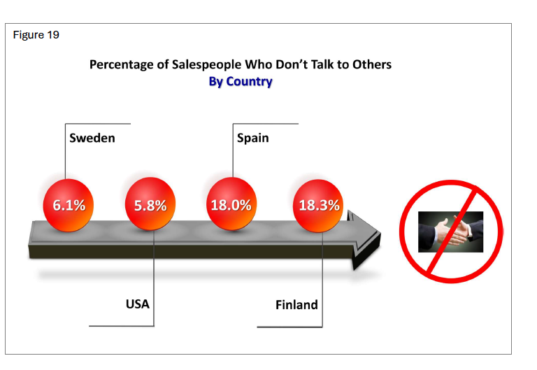
Salespeople “Who do not talk to others
Notes:
It is in the Job as a salesperson to initiate contact with prospects and customers. Still there are salespeople who are not comfortable with this. That is why it is so important to find out how many is there in your country, your industry and in your company. When we have more data from each country we maybe can and of course if you have the testresult from a single company we/you can find them.

Slide 20
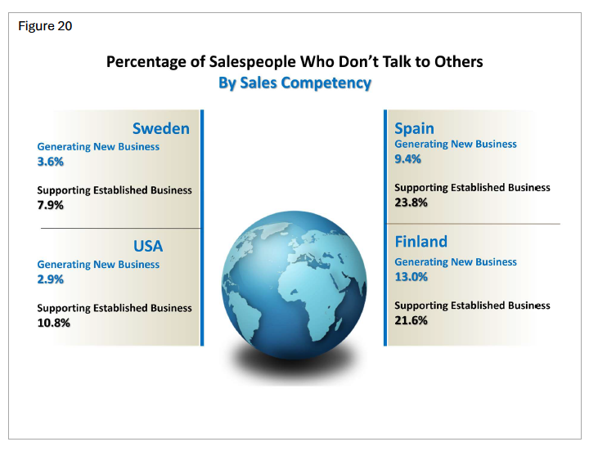
Salespeople “Who do not talk to others”
Notes:
Is there a difference between salespeople generating new business (Hunters) and those who is supporting established business (Farmers)

